Slide 1
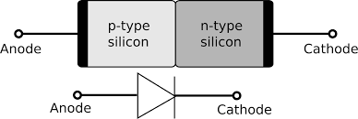
P- N DIODE
CIT, 1 Yr. CIT – 134.

Slide 2
CIT, 1 Yr. CIT – 134.

Slide 3
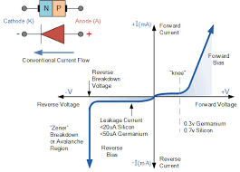
DIODE CHARECTERISTIC CURVE.
CIT, 1 Yr. CIT – 134.

Slide 4
CIT, 1 Yr. CIT – 134.

Slide 5
HALF WAVE RECTIFICATION
CIT, 1 Yr. CIT –134.

Slide 6
FULL WAVE RECTIFICATION
CIT, 1 Yr. CIT – 134.

Slide 7
During Positive Half Cycle
CIT, 1 Yr. CIT – 134.

Slide 8
During Negative Half Cycle
CIT, 1 Yr. CIT – 134.

Slide 9
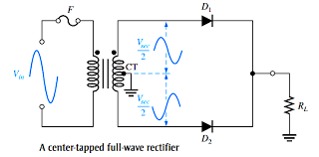
Center tapped full-wave rectifier
CIT, 1 Yr. CIT – 134.

Slide 10
During Positive Half Cycle
CIT, 1 Yr. CIT – 134.

Slide 11
During Negative Half Cycle
CIT, 1 Yr. CIT – 134.

Slide 12
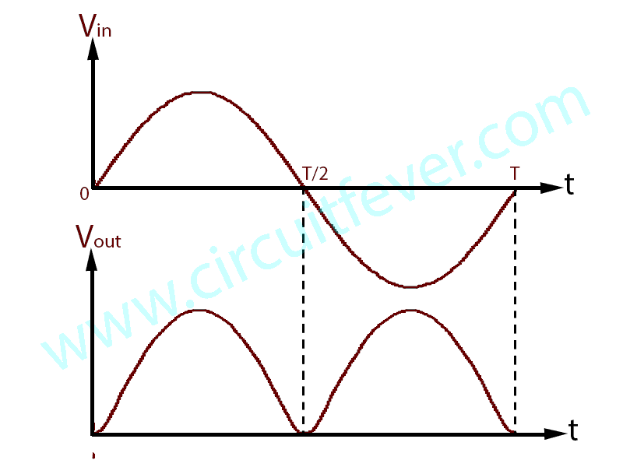
CIT, 1 Yr. CIT – 134.

